Slide 1
Identification of Tree Canopy in Different Challenging Backgrounds from UAV Imagery Using Deep Learning
Presented By:
Tapos Biswas
JN-092-003
4th Year 1st Semester
Department of Robotics and Mechatronics Engineering
University of Dhaka
Email: tapos7218@gmail.com
Ipshita Ahmed Moon
SK-092-017
4th Year 1st Semester
Department of Robotics and Mechatronics Engineering
University of Dhaka
Email: ipshitaam@gmail.com
Supervised By
Md. Shifat-E-Arman Bhuiyan
Lecturer
Department of Robotics and Mechatronics Engineering
University of Dhaka
Email: shifatearman@du.ac.bd

Slide 2
Contents
INTRODUCTION
RELATED WORKS
METHODOLOGY
RESULTS
CONCLUSION

Slide 3
INTRODUCTION

Slide 4
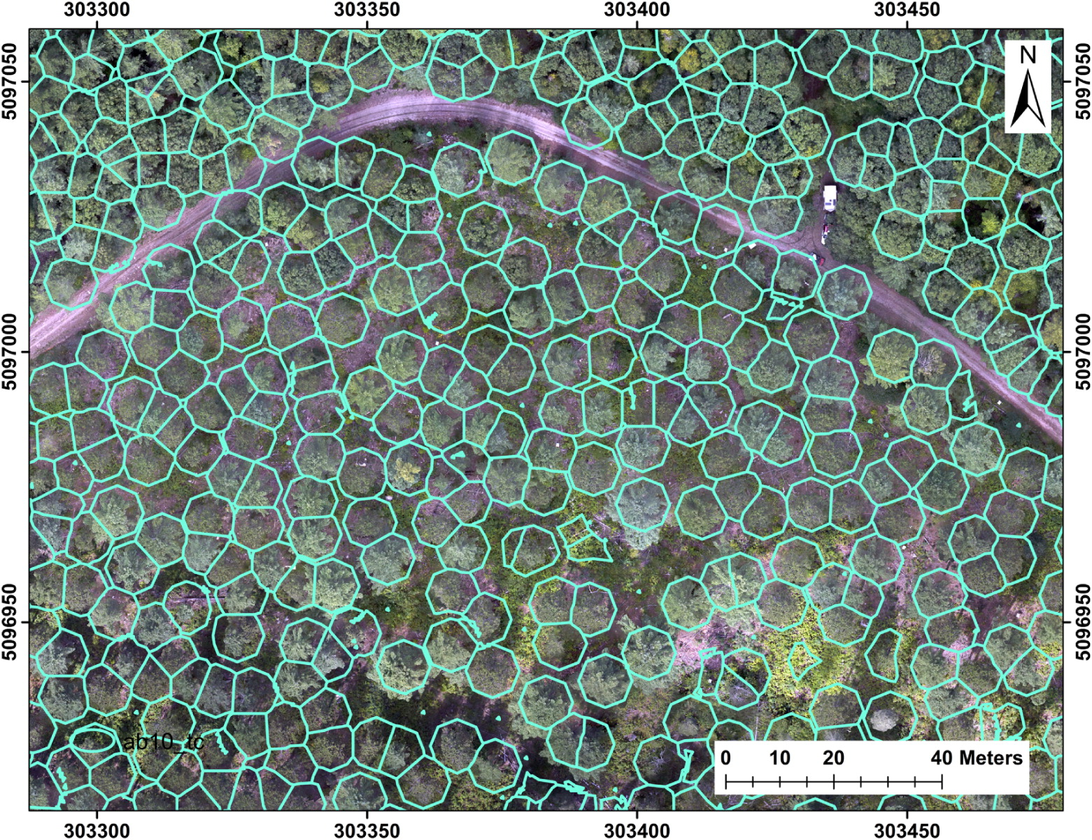
Canopy Identification
What is Tree Canopy Identification?
Fig 1: Canopy Segmentation [1]

Slide 5
Why Canopy Identification?
Agriculture and agroforestry
Urban planning
Forest management
Biodiversity conservation
Disaster management
Carbon sequestration

Slide 6
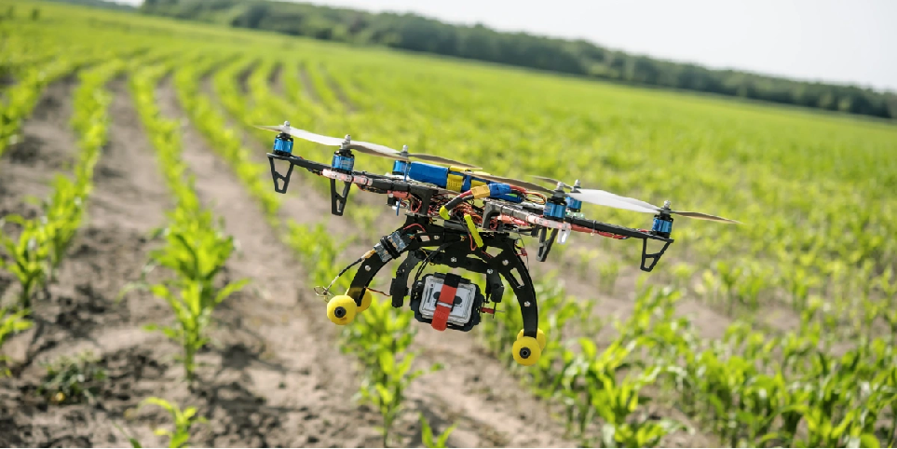
Unmanned Aerial Vehicle
“Drones overall will be more impactful than I think people recognize, in positive ways to help the society”
– Bill Gates
Fig. 2 : UAV in Agriculture [2]

Slide 7
RELATED WORK

Slide 8
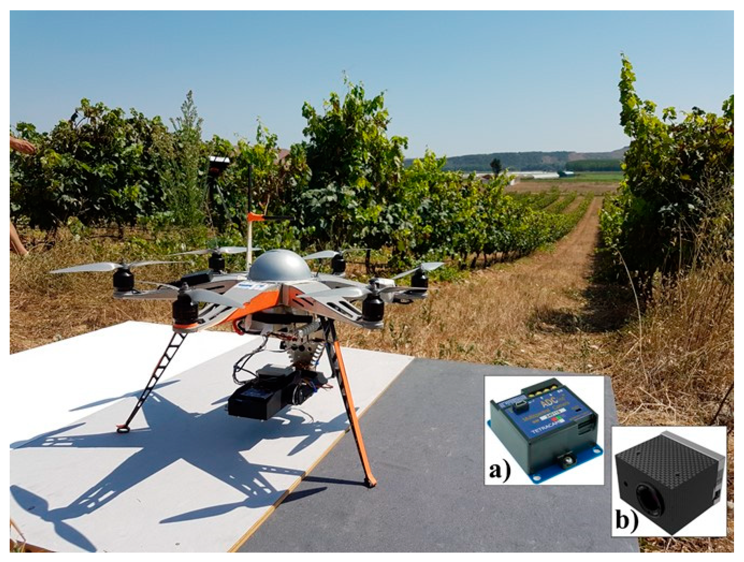
Comparison of Unsupervised Algorithms for Vineyard Canopy Segmentation from UAV Multispectral Images [4]
RGB(Red-Green-Blue) and NRG(Near Infrared-Red-Green) images
HSV(Hue, Saturation, Value), DEM(Digital Elevation Model) and K-means algorithms
Analyzation of over-estimation and under-estimation indexes
Limitations:
Computationally expensive
Less accurate
Figure 4: UAV platform equipped with (a) multi- spectral and (b) visible camera [4]

Slide 9
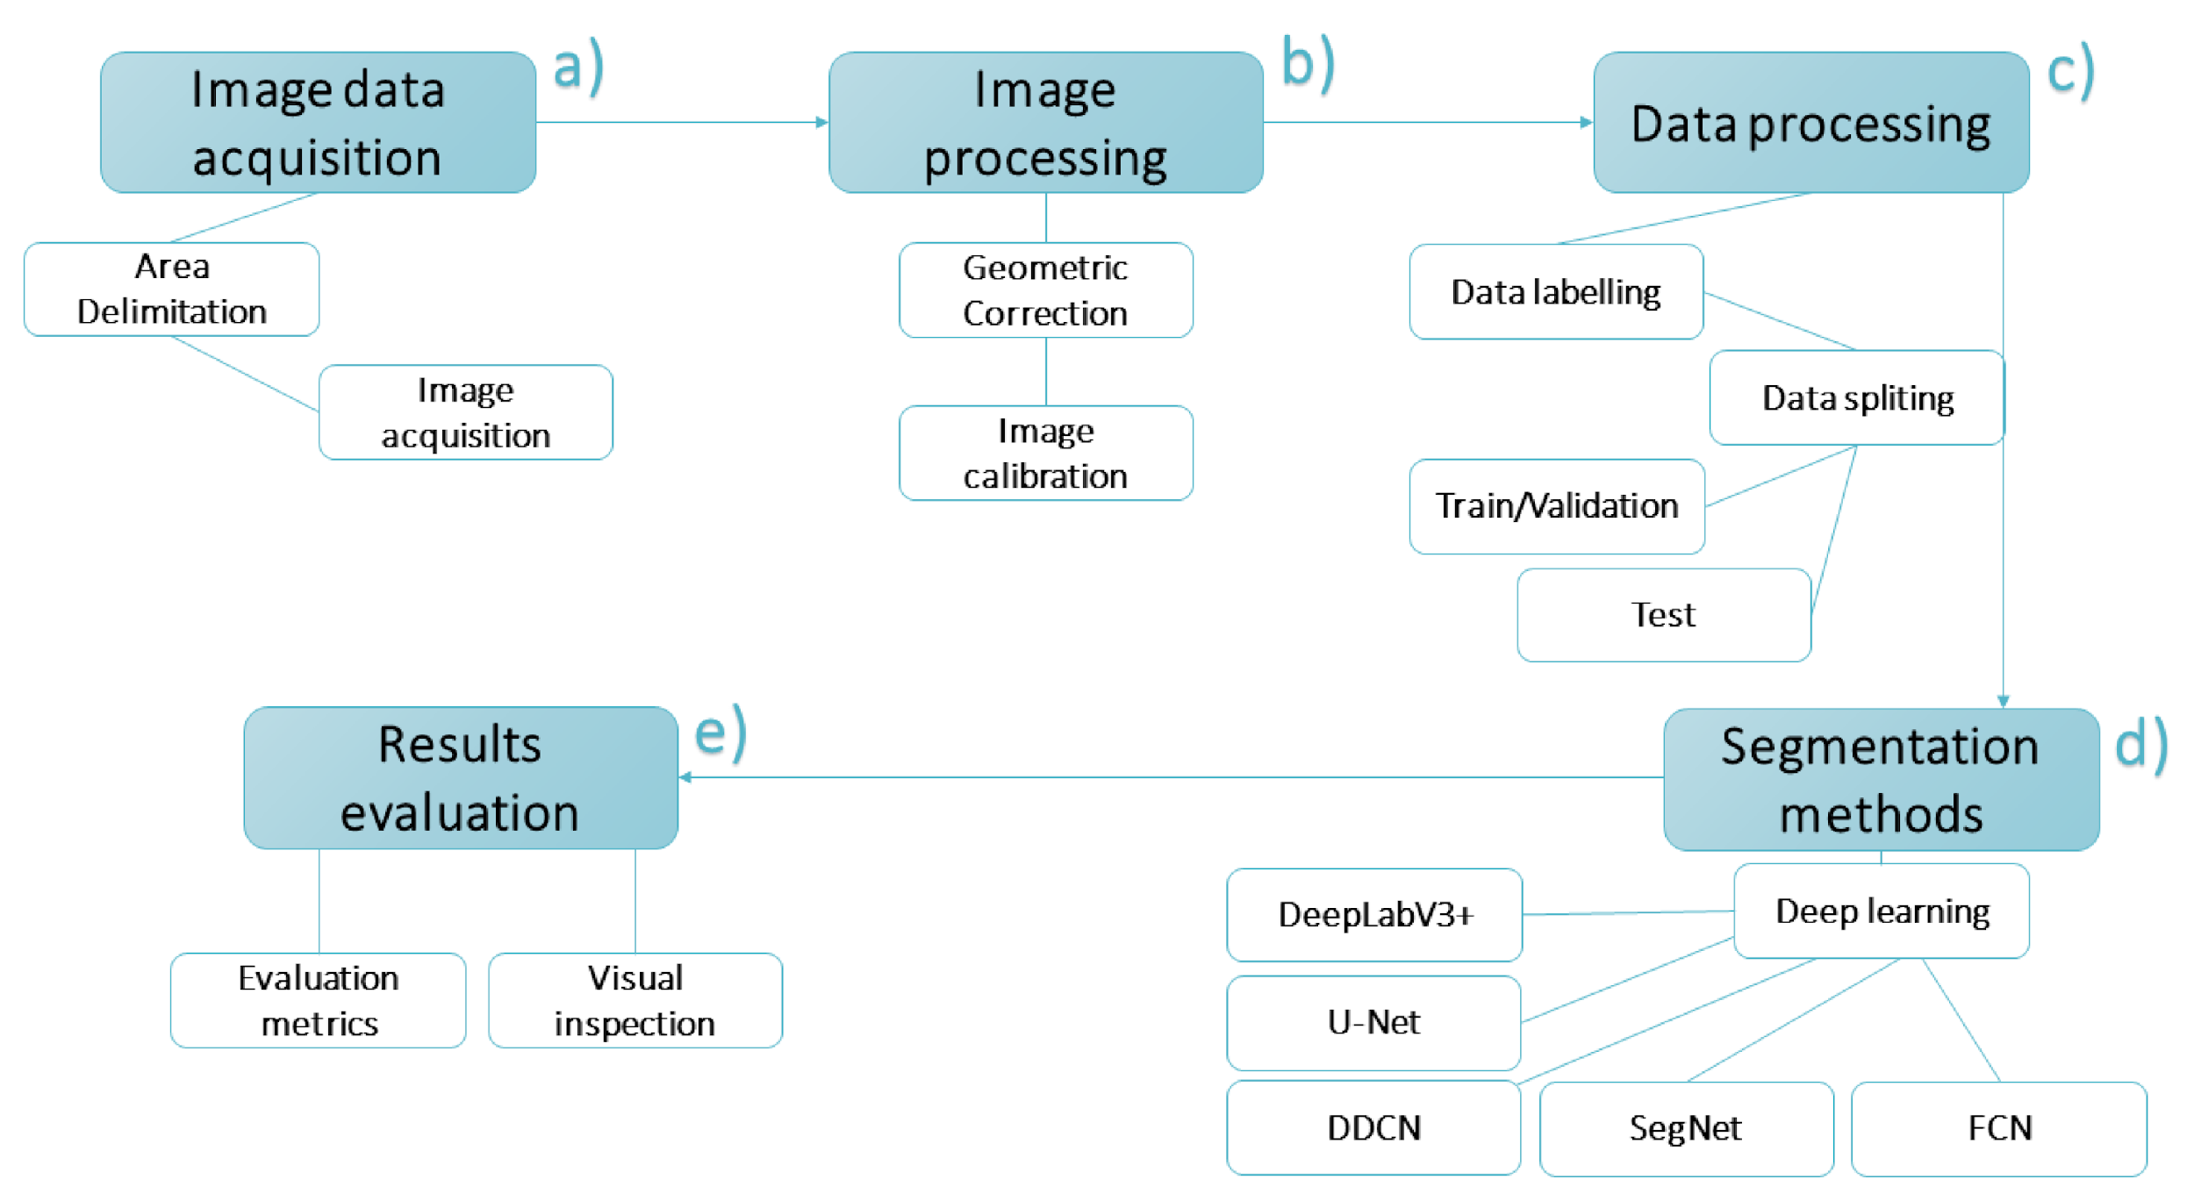
Semantic Segmentation of Tree-Canopy in Urban Environment with Pixel-Wise Deep Learning [5]
Aerial RGB imagery
FCN, U-Net, SegNet, Dynamic Dilated Convolution Network and DeepLabV3+
Greatly applicable in the urban context
Limitations:
Poor performance in the complex environment
Lack of generalization and the transferability
Figure 5: Workflow summarizing the fundamental steps of the conducted approach. [5]

Slide 10
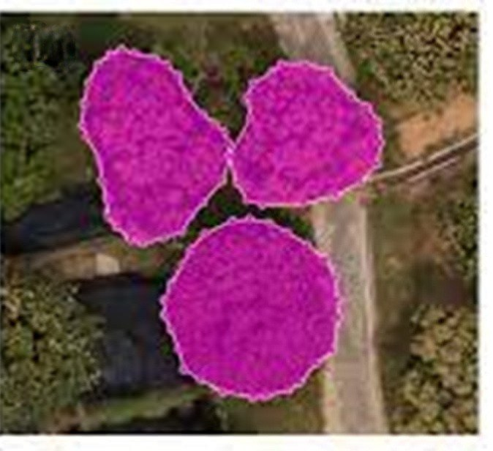
Deep Learning-Based Instance Segmentation Method of Litchi
Canopy from UAV-Acquired Images [6]
Simple structure
Lower requirements for data
Labor-friendly semi-auto annotation
Partition-based method
High-resolution digital orthophoto maps (DOMs)
Addition of citrus data
Limitations:
Computationally costly
Figure 6: objects in the sampling process [6]

Slide 11
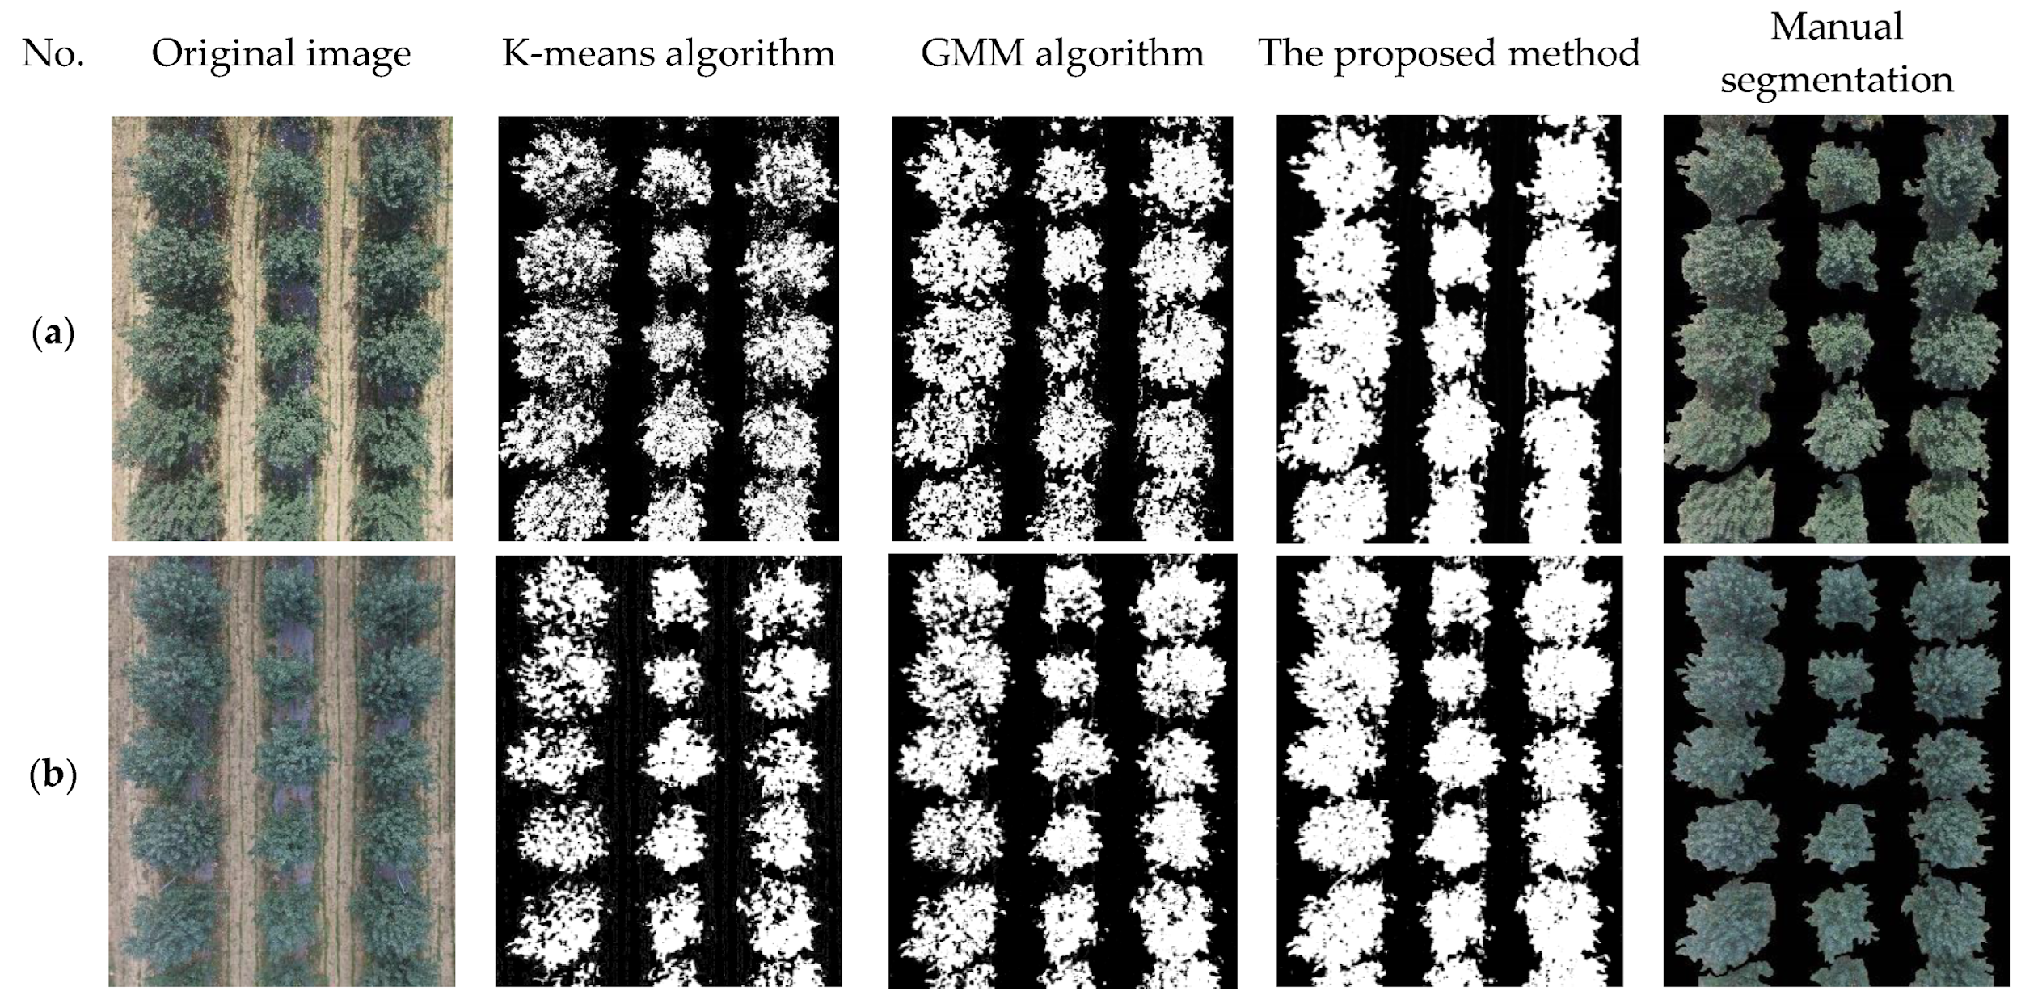
Image Segmentation of UAV Fruit Tree Canopy in a Natural
Illumination Environment [7]
Unsupervised method
Shadow region luminance compensation method (SRLCM)
Effective reduction of shadow effect
Combined multiple clustering algorithms
Better than ordinary K-means and GMM (Gaussian Mixture Model)
Limitations:
Higher response time than K-means
Figure 7: Comparison of the different segmentation result [7]

Slide 12
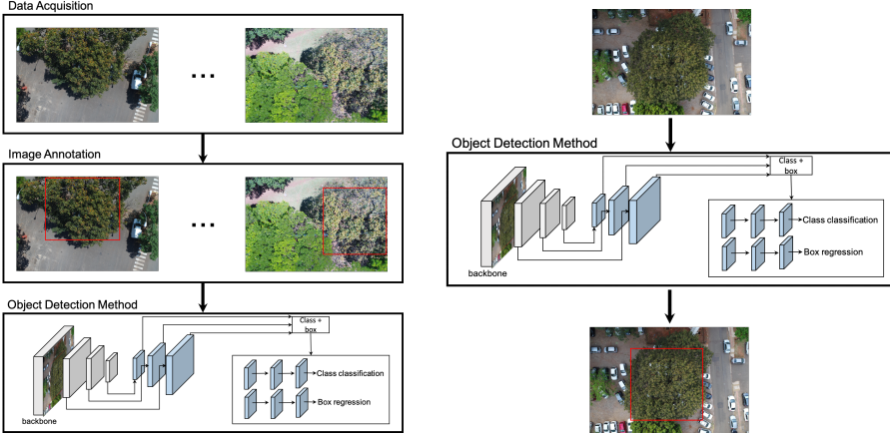
Assessment of CNN-Based Methods for Individual Tree Detection on Images Captured by RGB Cameras Attached to UAVs [5]
RGB(Red-Green-Blue) UAV images
Faster R-CNN, YOLOv3 and RetinaNet
Robustness to variations in lighting and scale conditions
Limitations:
Limited dataset
Lack of real-time performance
Figure 4: Annotated UAV images trained the detection network for Cumbaru tree detection in test images [5]

Slide 13
METHODOLOGY

Slide 14
Flowchart Showing the overall Methodology
Public Dataset
Dataset Collected from Field
Cleaning data
Scaling features
Handling categorical data
Divide into train, validation, and test set
Data
Acquisition
Data
Pre-processing
Splitting
the Data
Define model architecture and hyperparameter
Train on training dataset
Train
model
Host model
Handle input/output
Tune hyperparameters
Add regularization
Choose the correct metrics
Evaluate the test set
Deployment
Hyperparameter Tuning
Evaluate Performance
‹#›

Slide 15
Available Dataset
Datasets
Tree Species Detection
NeonTreeEvaluation Benchmark
Forest Damages - Larch Casebearer

Slide 16
Applied Methods
Methods
Faster R-CNN
Mask R-CNN
YOLOv5

Slide 17
Evaluation Metrics
Metrics
Precision
Recall
mAP50
F1 score

Slide 18
Work to be Done
Applying Faster R-CNN and Mask R-CNN on the Forest Damages - Larch Casebearer dataset properly to ensure optimal performance
New data acquisition
Data augmentation
Applying other models
Hyperparameter Tuning
Compare with benchmark models

Slide 19
RESULTS

Slide 20
Results on Tree Species Detection Dataset
Evaluation Metrics Comparison
Variant | Precision | Recall | mAP50 | F1 Score
Faster R-CNN | 34.54% | 49.4% | 58.0% | 40.6%
Mask R-CNN | 41.1% | 46.8% | 67.3% | 43.8%
YOLOv5 | 81.2% | 77.2% | 79.0% | 79.2%
Model Complexity Comparison
Method | Training Time | Inference Time | Model Size
Faster R-CNN | 2329 s | 16ms | 314 MB
Mask R-CNN | 2228 s | 16.1ms | 334 MB
YOLOv5 | 576 s | 1.6 ms | 14.4 MB

Slide 21
Results on NeonTreeEvaluation Benchmark Dataset
Evaluation Metrics Comparison
Variant | Precision | Recall | mAP50 | F1 Score
Faster R-CNN | 25.5% | 36.5% | 42.9% | 30.0%
Mask R-CNN | 30.17% | 34.4% | 49.53% | 32.1%
YOLOv5 | 66.4% | 56.7% | 58.4% | 61.2%
Model Complexity Comparison
Method | Training Time | Inference Time | Model Size
Faster R-CNN | 374 s | 8.5 ms | 314 MB
Mask R-CNN | 518 s | 7.4 ms | 334 MB
YOLOv5 | 460.8 s | 1.0 ms | 14.3

Slide 22
Results on Forest Damages - Larch Casebearer Dataset
Evaluation Metrics Comparison
Variant | Precision | Recall | mAP50 | F1 Score
YOLOv5 | 74.2% | 70.4% | 76.5% | 72.3%
Model Complexity Comparison
Method | Training Time | Inference Time | Model Size
YOLOv5 | 49176 s | 0.5 ms | 15.4 MB

Slide 23
CONCLUSION

Slide 25
Reference
[1] S. Natesan, C. Armenakis, and U. Vepakomma, “Individual tree species identification using dense convolutional network (densenet) on multitemporal rgb images from uav,” Journal of Unmanned Vehicle Systems, vol. 8, no. 4, pp. 310–333, 2020.
[2] https://www.technologyreview.com/2016/07/20/158748/six-ways-drones-are-revolutionizing-agriculture/
[3] https://sites.google.com/a/coe.edu/principles-of-structural-chemistry/relationship-between-light-and-matter/electromagnetic-spectrum
[4] P. Cinat, S. F. Di Gennaro, A. Berton, and A. Matese, “Comparison of unsupervised algorithms for vineyard canopy segmentation from uav multispectral images,” Remote Sensing, vol. 11, no. 9, p. 1023, 2019.
[5] J. A. C. Martins, K. Nogueira, L. P. Osco, F. D. G. Gomes, D. E. G. Furuya, W. N. Gon ̧calves, D. A. Sant’Ana, A. P. M. Ramos, V. Liesenberg, J. A. dos Santos et al., “Semantic segmentation of tree-canopy in urban environment with pixel-wise deep learning,” Remote Sensing, vol. 13, no. 16, p. 3054, 2021.
[6] J. Mo, Y. Lan, D. Yang, F. Wen, H. Qiu, X. Chen, and X. Deng, “Deep learning-based instance segmentation method of litchi canopy from uav- acquired images,” Remote Sensing, vol. 13, no. 19, p. 3919, 2021
[7] Z. Lu, L. Qi, H. Zhang, J. Wan, and J. Zhou, “Image segmentation of uav fruit tree canopy in a natural illumination environment,” Agriculture, vol. 12, no. 7, p. 1039, 2022.

Slide 26
Thank You

